Slide 1
Keystroke Logging in Second Language Writing Research Third Presentation
Joo Hyun Lee, Logan Tidstrom, Fabio Pruneri

Slide 2
Background
Keystroke logging provides a more natural look at the writing process
Important terms: burst, pause, revision
Challenges: pure data does not reveal reasons for burst, pause, revision, etc. —> data analysis and conclusions

Slide 3
Overview of the Research
Keystroke Logging data of Students
Using this keystroke logging data, find the correlation between the keystroke patterns and the cognitive process underlying
We will quantify the cognitive effort by the complexity of the sentence using CoCoGen

Slide 4
Questions we would like to answer
Will people pause longer while typing when writing a more complex sentence?
Does burst length indicate fluency in second language?
If more time is spent on revising the text, is the quality of the text better?

Slide 5
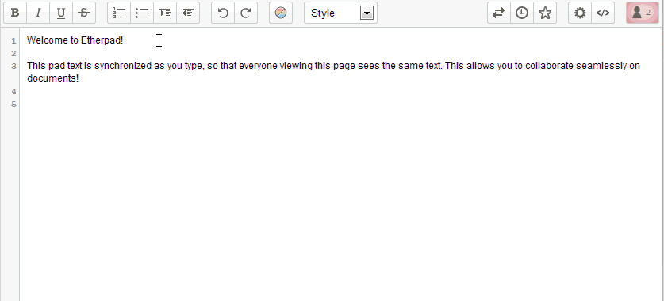
Retrieving Data - Etherpad

Slide 6
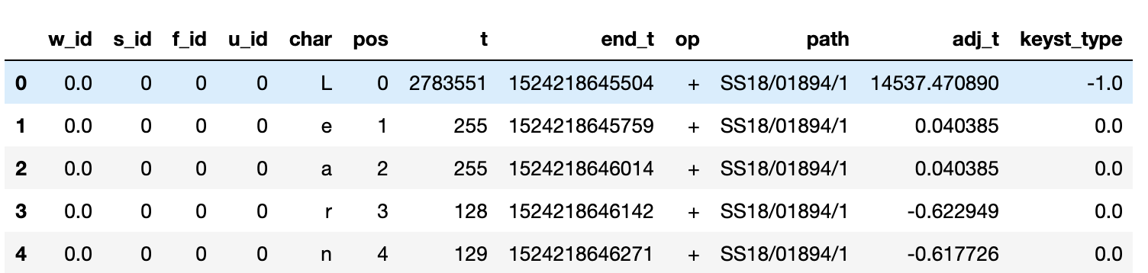
Pre-processing
Changeset to easily comprehensible Pandas DataFrame

Slide 7
Pre-processing
Data Clean-up
Copy-pasted Sentences excluding sentences that were moved (cut, pasted) inside the text
Sentence with 0-5 length
Abnormally long sentences because of stanford-corenlp parsing issues
Other things (bullet points, lists etc.)

Slide 8
FORMAT
Put everything into .csv format
Readable in one line by Pandas and all major data processing libraries
Everybody can now use this data with very little effort
Our code base also helps with functions for reading and basic processing
1GB in size

Slide 9
Statistics of Data
Before Data Clean-up
After Data Clean-up
Data | Number
Writers | 660
Files | 7,012
Sentences
Word
Keystrokes
Size | ~3 GB
Data | Number
Writers | 513
Files | 3,466
Sentences | 95,354
Word | 1,831,361
Keystrokes | 14,966,923
Size | ~1 GB

Slide 10
What each of us found so far

Slide 11
Joo

Slide 12
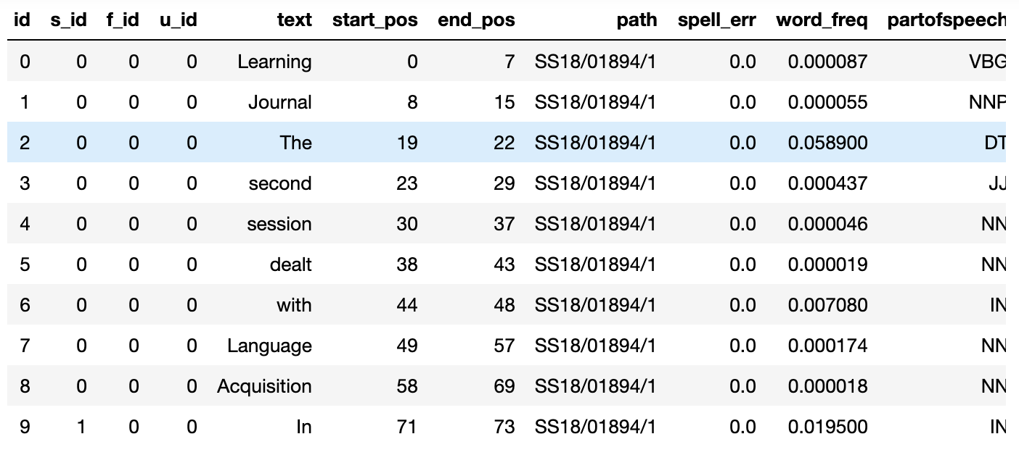
Words
Spelling errors, word frequency, part of speech

Slide 13
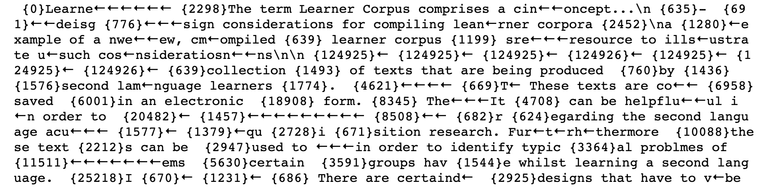
Visualization of burst
def get_burstlist(file_id,p_threshold):
Function that returns list of bursts with
a specific file id and pause threshold
{t} is a pause of length t milliseconds

Slide 14
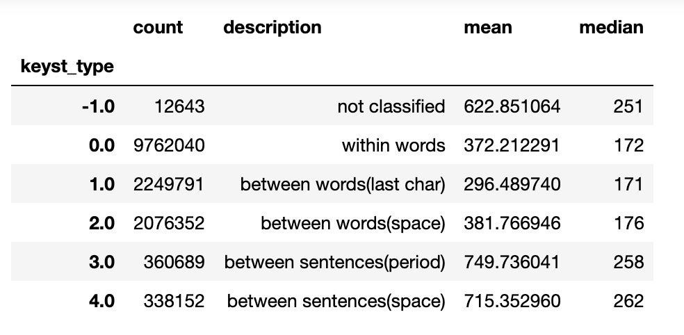
Categorization of Keystrokes
Categorizes keystrokes into five types: within words, between words (before, after space), between sentences (before, after space)
Mean and median pause length of different types of keystrokes
Can be a key to where the cognitive effort occurs in a text

Slide 15
Logan

Slide 16
Visualizations
providing graphical representation of data to recognize anomalies and patterns

Slide 17
Visualizations

Slide 20
Word_t vs. Separator_t

Slide 21
Syntactic / Lexical Complexity

Slide 22
Syntactic / Lexical Complexity

Slide 23
FABIO

Slide 24
I’M lazy so look at my jupyter notebook :)

Slide 25
PLANS

Slide 26
WORD and n-gram
Done:
Splitting keystrokes into words with user and file identifiers
Word frequency and spelling mistakes
Todo:
Why do LONG breaks happen in the middle of a word?
German vs Latin origin? Part of speech?
Ngrams: Create dataframe and get most frequent
Average speed and longest pause -> bursts
Difference between users?

Slide 27
Sentence
Done:
Statistics from keystroke data and Cocogen
Preliminary analysis
Todo: (more analysis)
Finish Cocogen measures and correlation with time
Syntactis measures from other libraries?
Differences between users (estimating proficiency): Easy vs hard sentence comparison/speed diff? Or just hard ones?

Slide 28
FILE
Done:
Statistics and normalization by user
Preliminary graphics and exploration
Todo: (more analysis)
Time spent and revision over the length of the file?
Diff in distribution between users?
Compare with cocogen contour
Nice graphics and case study for presentation

Slide 29
Timeline
6/24 - 6/28: Finish finding 3-5 statistically significant things each from the data
7/1 - 7/5: Make nice visualizations and polish the data for the paper
7/8 - 7/12: Flesh out intro and conclusions and write paper
7/15 - 7/18: Complete posters and presentation for Symposium
7/19: Symposium!

Slide 30
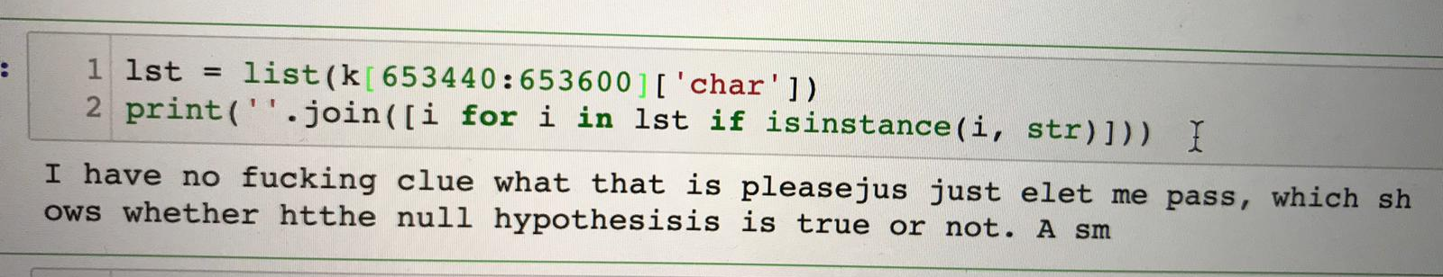
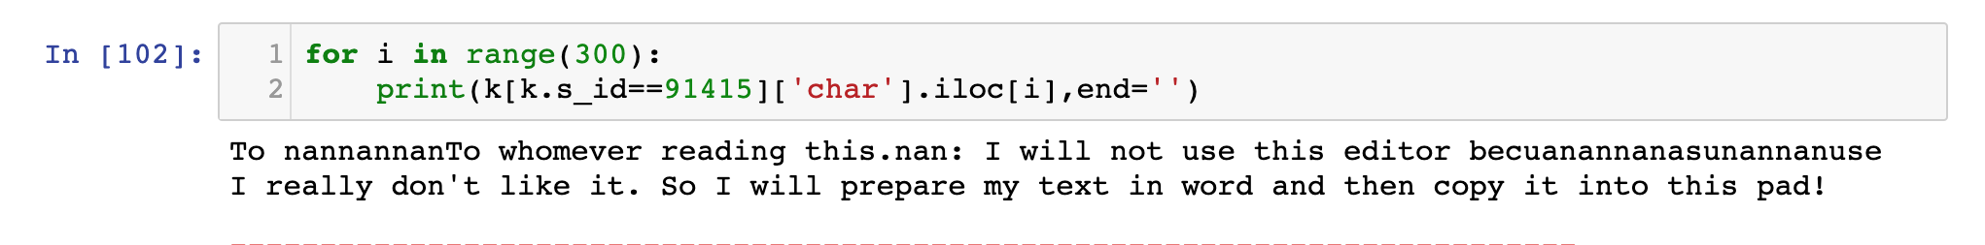
Some fun stuff we found

